Slide 1
Healthy eating habits
Danni Li — 45008753
Edward Carroll — 44806336
Mingyang LYU — 45037481
Ziyi Xu — 45480171
Team Broccoli

Slide 2
CONTENTS
Introduction
Research conclusions
Experience Requirements
Prototype
Conclusion

Slide 3
Domain
Healthy eating habits & lose weight

Slide 4
Research
01
02
05
03
04
Over 90% people were either unhappy or would like to improve their nutritional lifestyle.
60% of people interviewed said they didn’t know how to change.
Users want to be provided with the information on how to change.
Users often lose motivation due to a lack of change or progress.
Users either want to focus on losing weight or gaining muscle

Slide 5
Experience requirements
A.
E.
B.
D.
C.
Problems or opportunities
Unsatisfied with body shape
Need help from others
Lack of time for exercise
Lack of motivation
Can not keep using relative applications

Slide 6
Experience requirements
Design implications
Aiming to diet not fitness
Make the tracking process a game to attract users
Set bonus and rewards to motivate users
Location based function

Slide 7
Ideas
recommending weight loss plans according to users' physical condition
recording user's eating data by feeding pets
rewarding users who achieve their goals with bonuses
setting up the communication area for them to discuss
tracking user data
providing the user with access to educational resources
aimed to encourage users to make changes to their current lifestyle to avoid these health risks

Slide 8
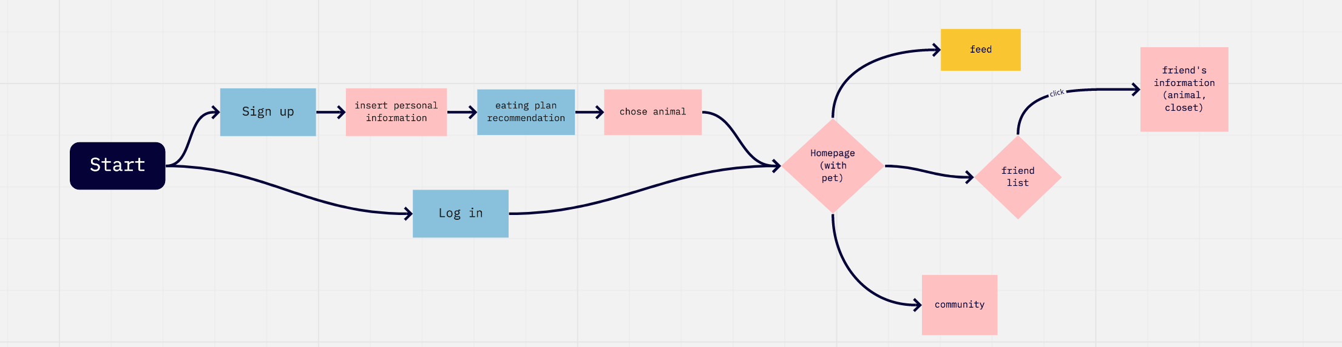
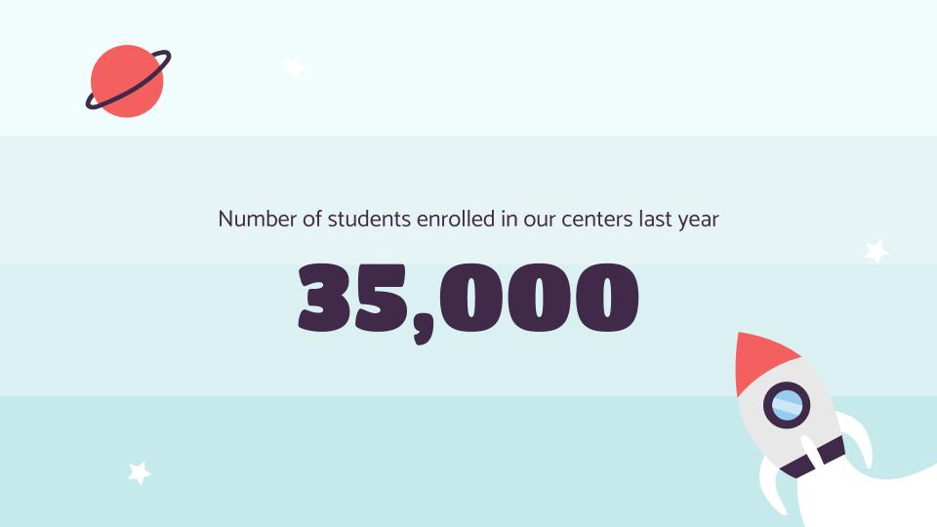
workflow

Slide 9
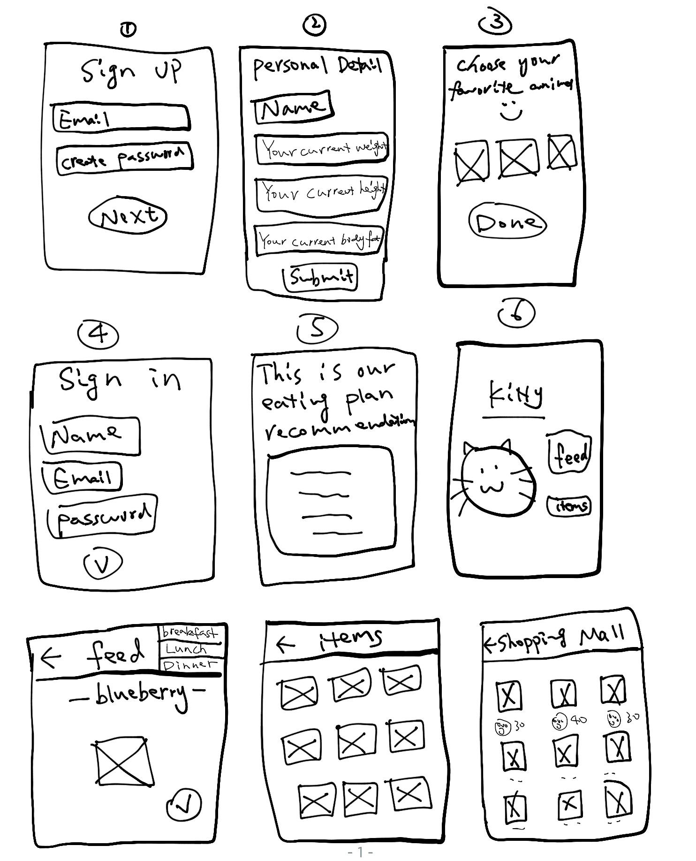
prototype

Slide 10
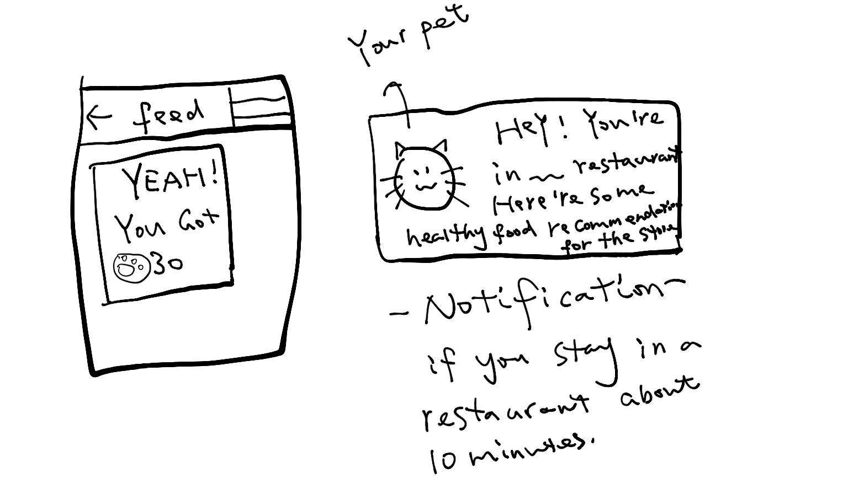
OUR ACADEMIC AREAS
01.
04.
02.
05.
03.
06.
Despite being red, Mars is actually a cold place full of iron oxide dust
Venus has a beautiful name and is the second planet from the Sun. It’s terribly hot
Mercury is the closest planet to the Sun and the smallest one in the Solar System
Neptune is the fourth-largest planet by diameter in the Solar System
Saturn is a gas giant, composed mostly of hydrogen and helium
Jupiter is a gas giant and the biggest planet in the Solar System

Slide 11
What we will do next
Improve our prototype
Continue user testing

Slide 12
Thanks

